Slide 1
ARP-DHCP
From Liebeherr / El-Zarki Lecture Notes

Slide 2
ARP (Address Resolution Protocol)

Slide 3
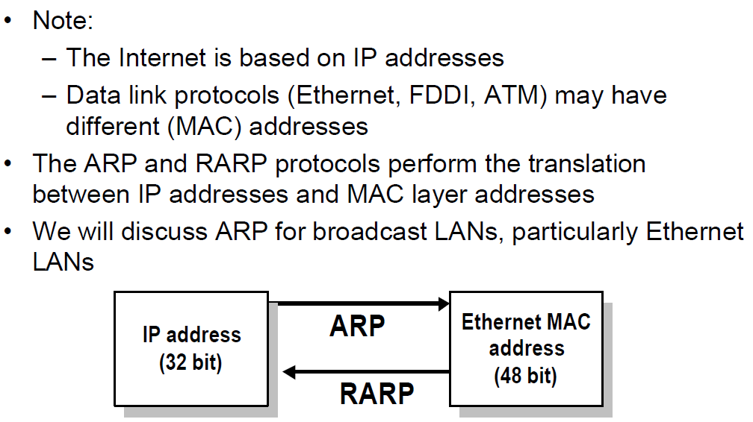
ARP and RARP

Slide 4
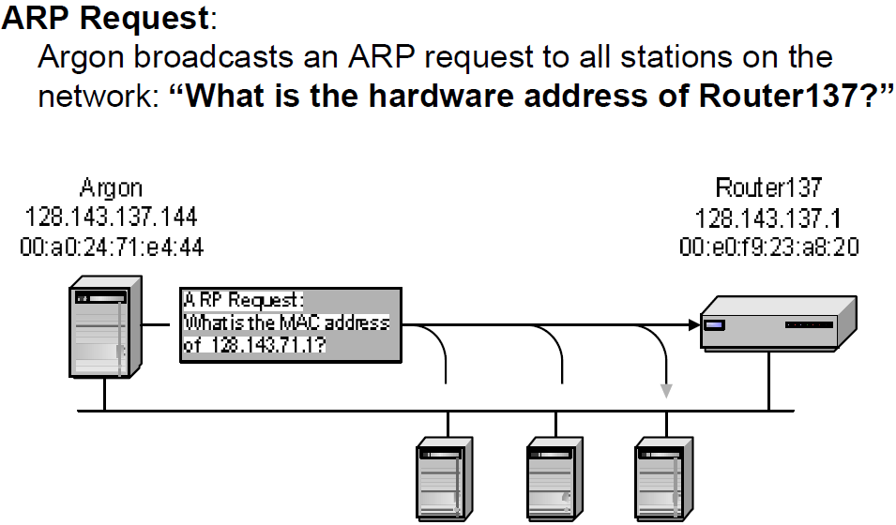
Address Translation with ARP

Slide 5
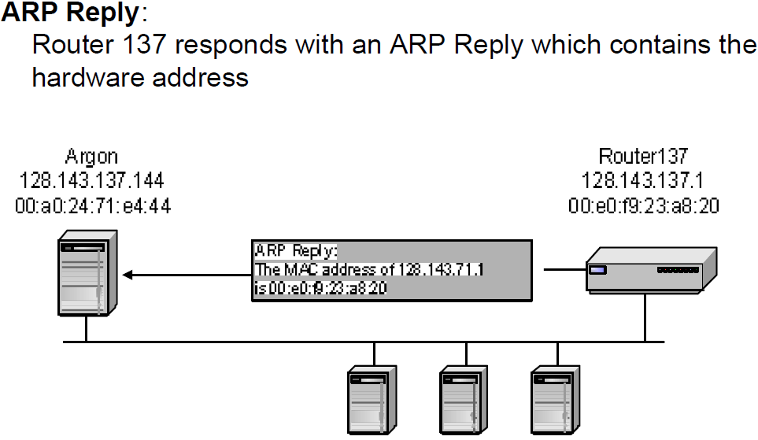
Address Translation with ARP

Slide 6
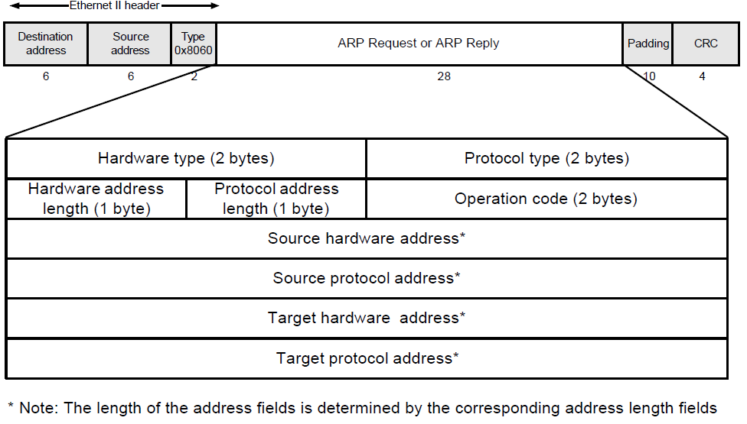
ARP Packet Format

Slide 7
Example
ARP Request from Argon:
Source hardware address:
Source protocol address:
Target hardware address:
Target protocol address:
ARP Reply from Router137:
Source hardware address:
Source protocol address:
Target hardware address:
Target protocol address:
00:a0:24:71:e4:44
128.143.137.144
ff:ff:ff:ff:ff:ff
128.143.137.1
Target hardware address is unknown thus the broadcast
00:e0:f9:23:a8:20
128.143.137.1
00:a0:24:71:e4:44
128.143.137.144

Slide 8
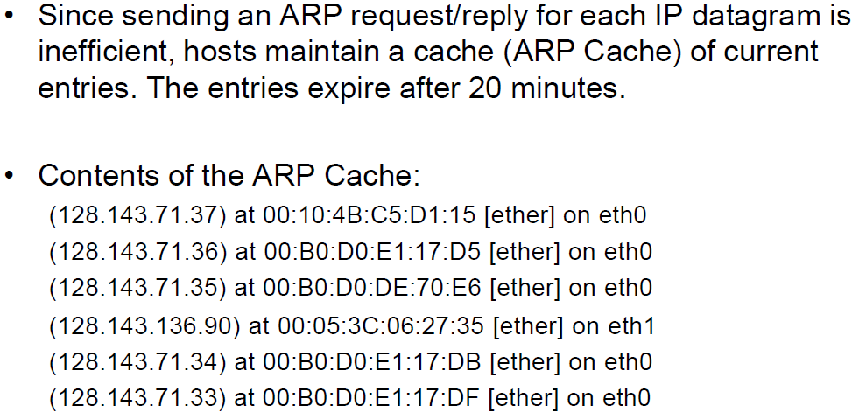
ARP Cache

Slide 9
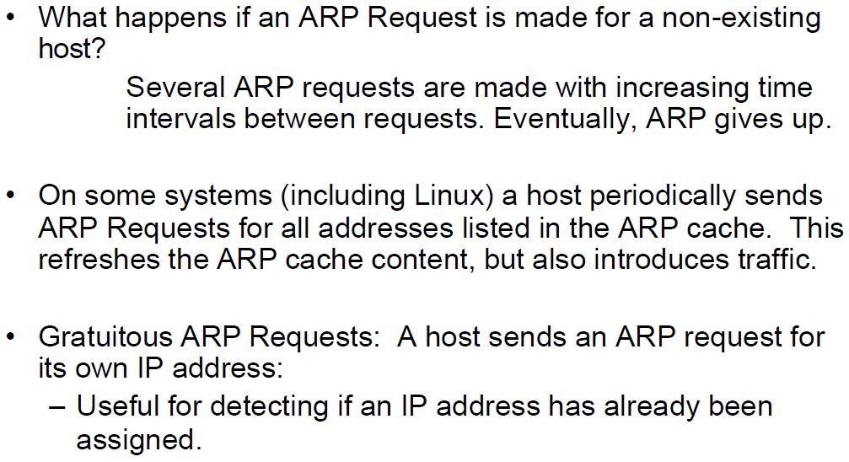
Things to know about ARP

Slide 10
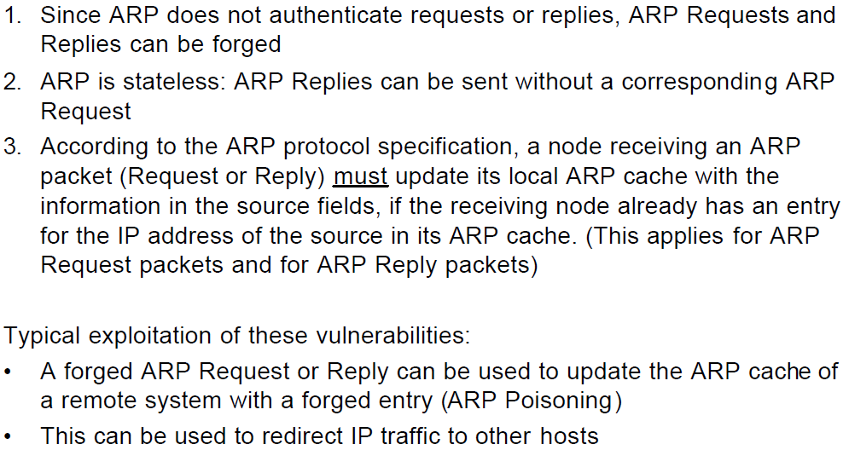
ARP Vulnerabilities

Slide 11
DHCP
(Dynamic Host Configuration Protocol)

Slide 12
Dynamic Assignment of IP addresses
Dynamic assignment of IP addresses is desirable for several reasons:
- IP addresses are assigned on-demand
- Avoid manual IP configuration
- Support mobility (laptops, phones, IoTs devices, ...)
Three Protocols:
- RARP (until 1985, no longer used)
- BOOTP (1985-1993)
- DHCP (since 1993)
Only DHCP is widely used today.

Slide 13
Solutions for dynamic assignment of IP addresses
Reverse Address Resolution Protocol (RARP)
- RARP is no longer used
- Works similar to ARP
- Broadcast a request for the IP address associated with a given MAC address
- RARP server responds with an IP address
- Only assigns IP address (not the default router and subnetmask)

Slide 14
BOOTP
BOOTstrap Protocol (BOOTP)
- Host can configure its IP parameters at boot time.
- Not only assigns IP address, but also default router, network mask, etc.
- Client sends UDP message (src addr 0.0.0.0) to server listening on port 67.
- Server responds with IP address to be given to the client that is listening on port 68.
- Use limited broadcast address (255.255.255.255):
- These addresses are never forwarded

Slide 15
DHCP
Dynamic Host Configuration Protocol (DHCP)
- Designed in 1993
- An extension of BOOTP (Many similarities to BOOTP)
- Same port numbers as BOOTP
- Extensions:
- Supports temporary allocation (“leases”) of IP addresses
- DHCP client can acquire all IP configuration parameters
- DHCP is the preferred mechanism for dynamic assignment of IP addresses
- DHCP can interoperate with BOOTP clients.

Slide 16
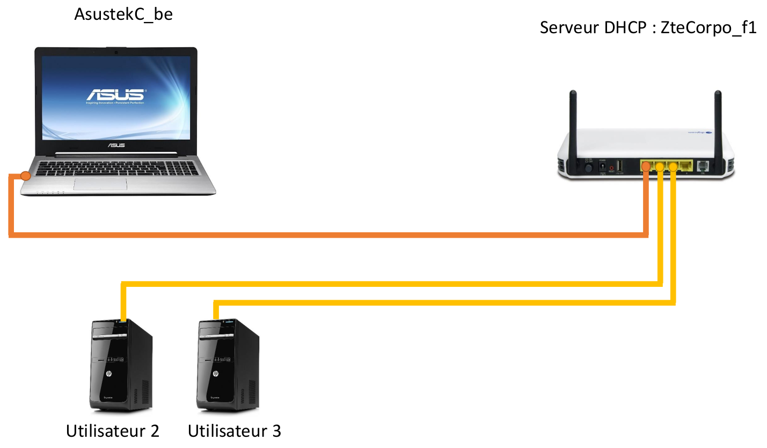
DHCP Messages
Capturing DHCP exchanged messages using wireshark at the Asus user

Slide 17
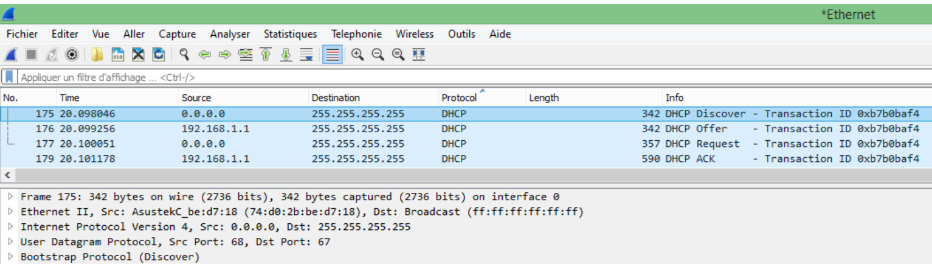
DHCP exchanged messages

Slide 18
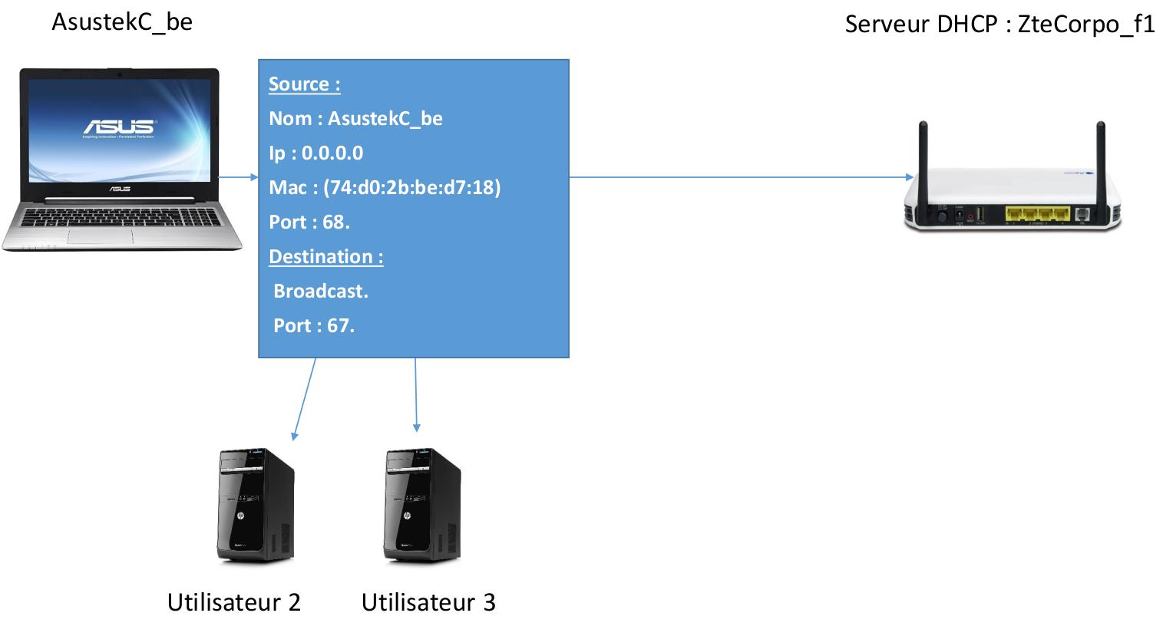
DHCP Discover

Slide 19
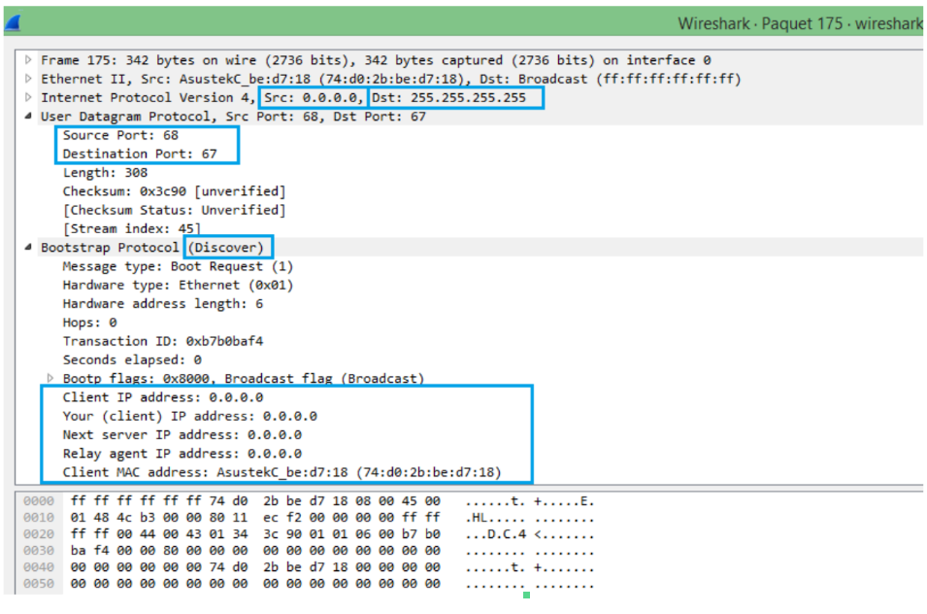
DHCP Discover (Details)

Slide 20
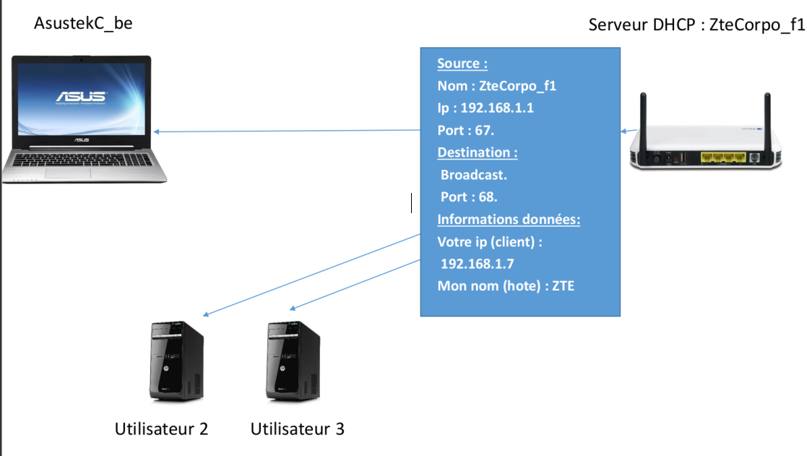
DHCP Offer

Slide 21
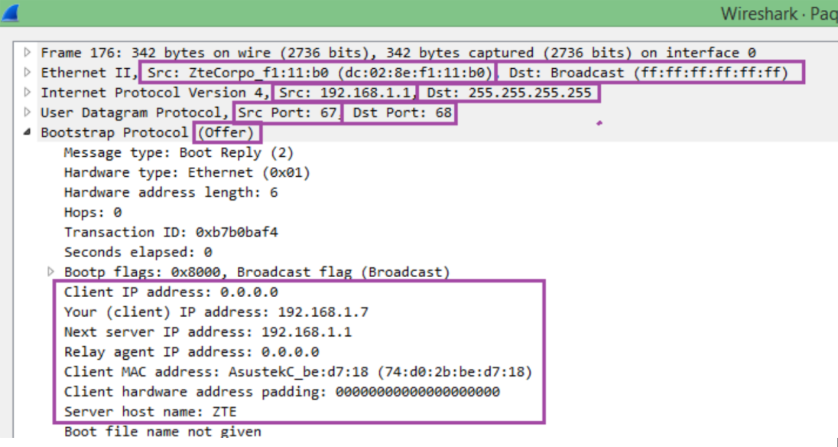
DHCP Offer (Details)

Slide 22
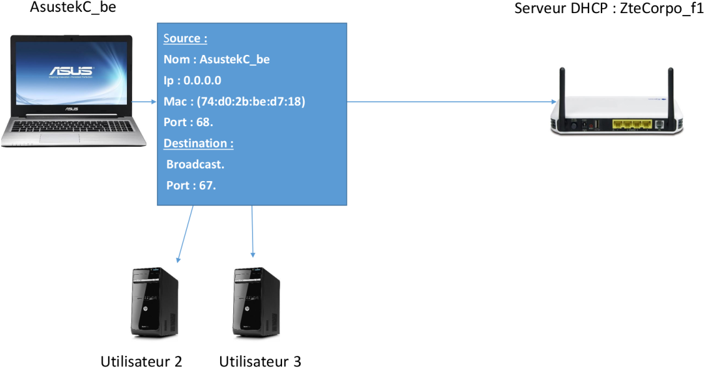
DHCP Request

Slide 23
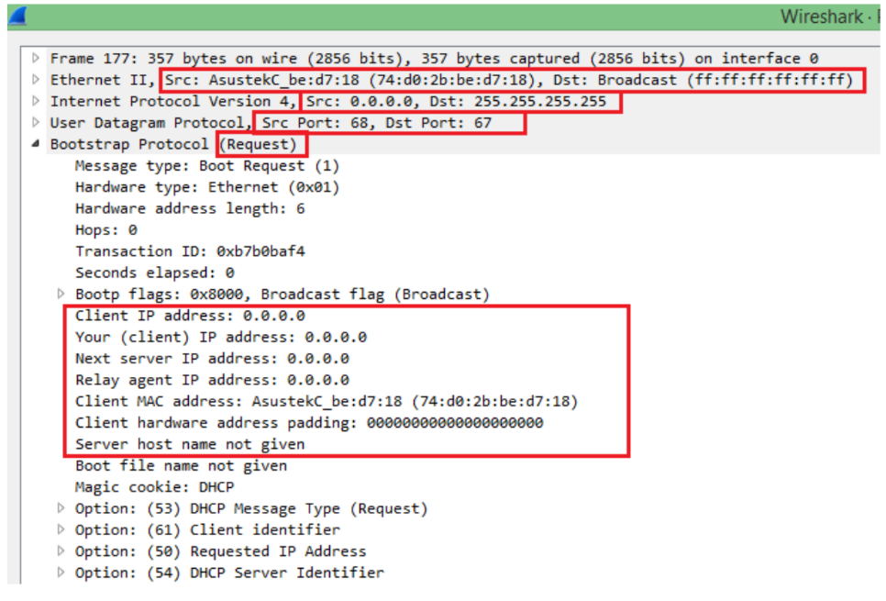
DHCP Request (Details)

Slide 24
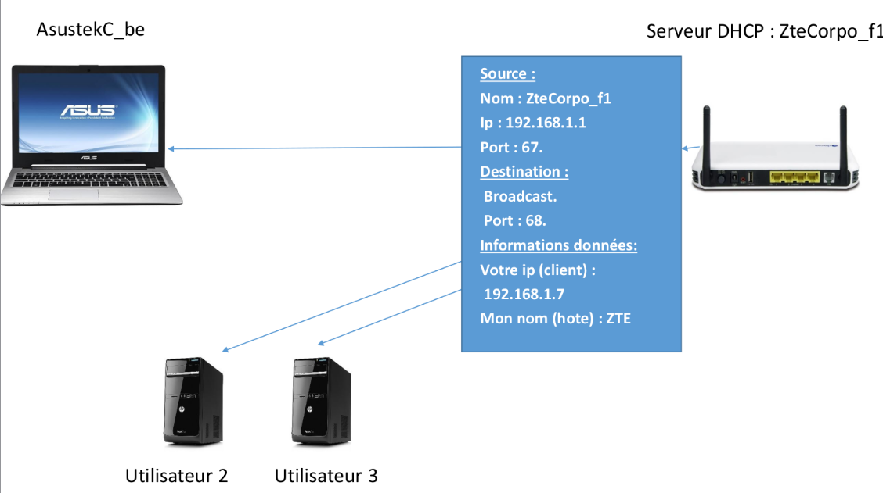
DHCP Acknowledge

Slide 25
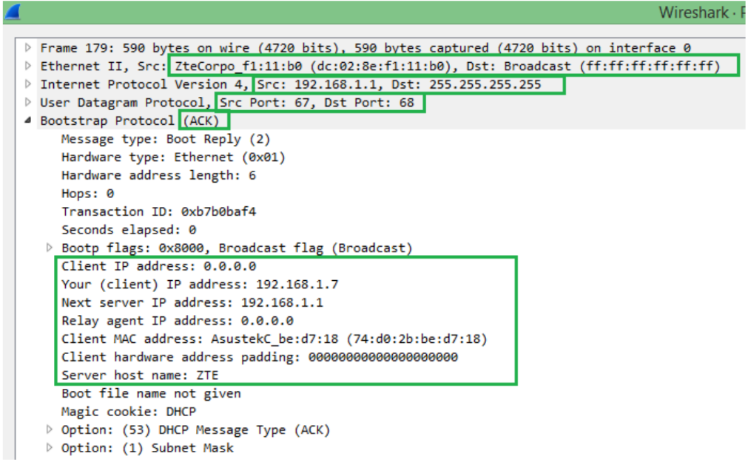
DHCP Acknowledge (Details)

Slide 26
DHCP/BOOTP Message format
(There are >100 different options)

Slide 27
DHCP/BOOTP
OpCode: 1 (Request), 2(Reply)
Note: DHCP message type is sent in an option
Hardware Type: 1 (for Ethernet)
Hardware address length: 6 (for Ethernet)
Hop count: set to 0 by client
Transaction ID: Integer (used to match reply to response)
Seconds: number of seconds since the client started to boot
Client IP address, Your IP address, server IP address, Gateway IP address, client hardware address, server host name, boot file name:
client fills in the information that it has, leaves rest blank

Slide 28
DHCP Message type
Value | Message Type
1 | DHCPDISCOVER
2 | DHCPOFFER
3 | DHCPREQUEST
4 | DHCPDECLINE
5 | DHCPACK
6 | DHCPNAK
7 | DHCPRELEASE
8 | DHCPINFORM
Message type is sent as an option

Slide 29
Other DHCP Options
Other DHCP information that is sent as an option:
Subnet Mask, Name Server, Hostname, Domain Name, Forward On/Off, Default IP TTL, Broadcast Address, Static Route, Ethernet Encapsulation, X Window Manager, X Window Font, DHCP Msg Type, DHCP Renewal Time, DHCP Rebinding, Time SMTP-Server, SMTP-Server, Client FQDN, Printer Name, …

